Slide 1
Solar Power & Biodiversity
WWCE Experience

Slide 2
Background
First community energy company formed by a Wildlife Trust
2014 Chelworth – 1MW
2016 Braydon Manor – 5MW (split site with private developer + 4.1MW)
Community fund
Society Objects includes:
‘Advancing, promoting and furthering the conservation, maintenance and long term protection of: wildlife and its habitats….’
Notes:
Chelworth = adjacent to WWT Blakehill Nature reserve
Also + 3 x rooftop schemes
Issues / barriers – construction, maintenance, operations, suitability for grazing?
Separating O&M and land mgt / biodiversity / ecological monitoring

Slide 3
Ethos

Slide 4
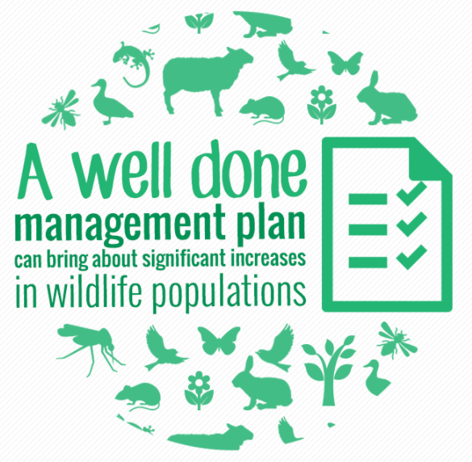

Slide 5
Focus

Slide 7
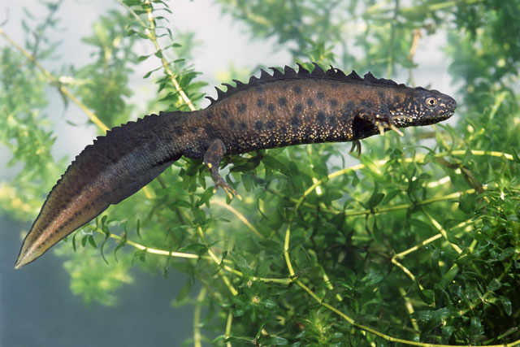
Notes:
Chelworth
Eight Great Crested Newts were found in the grassland habitat. They were temporarily moved under a European Protected Species licence

Slide 8
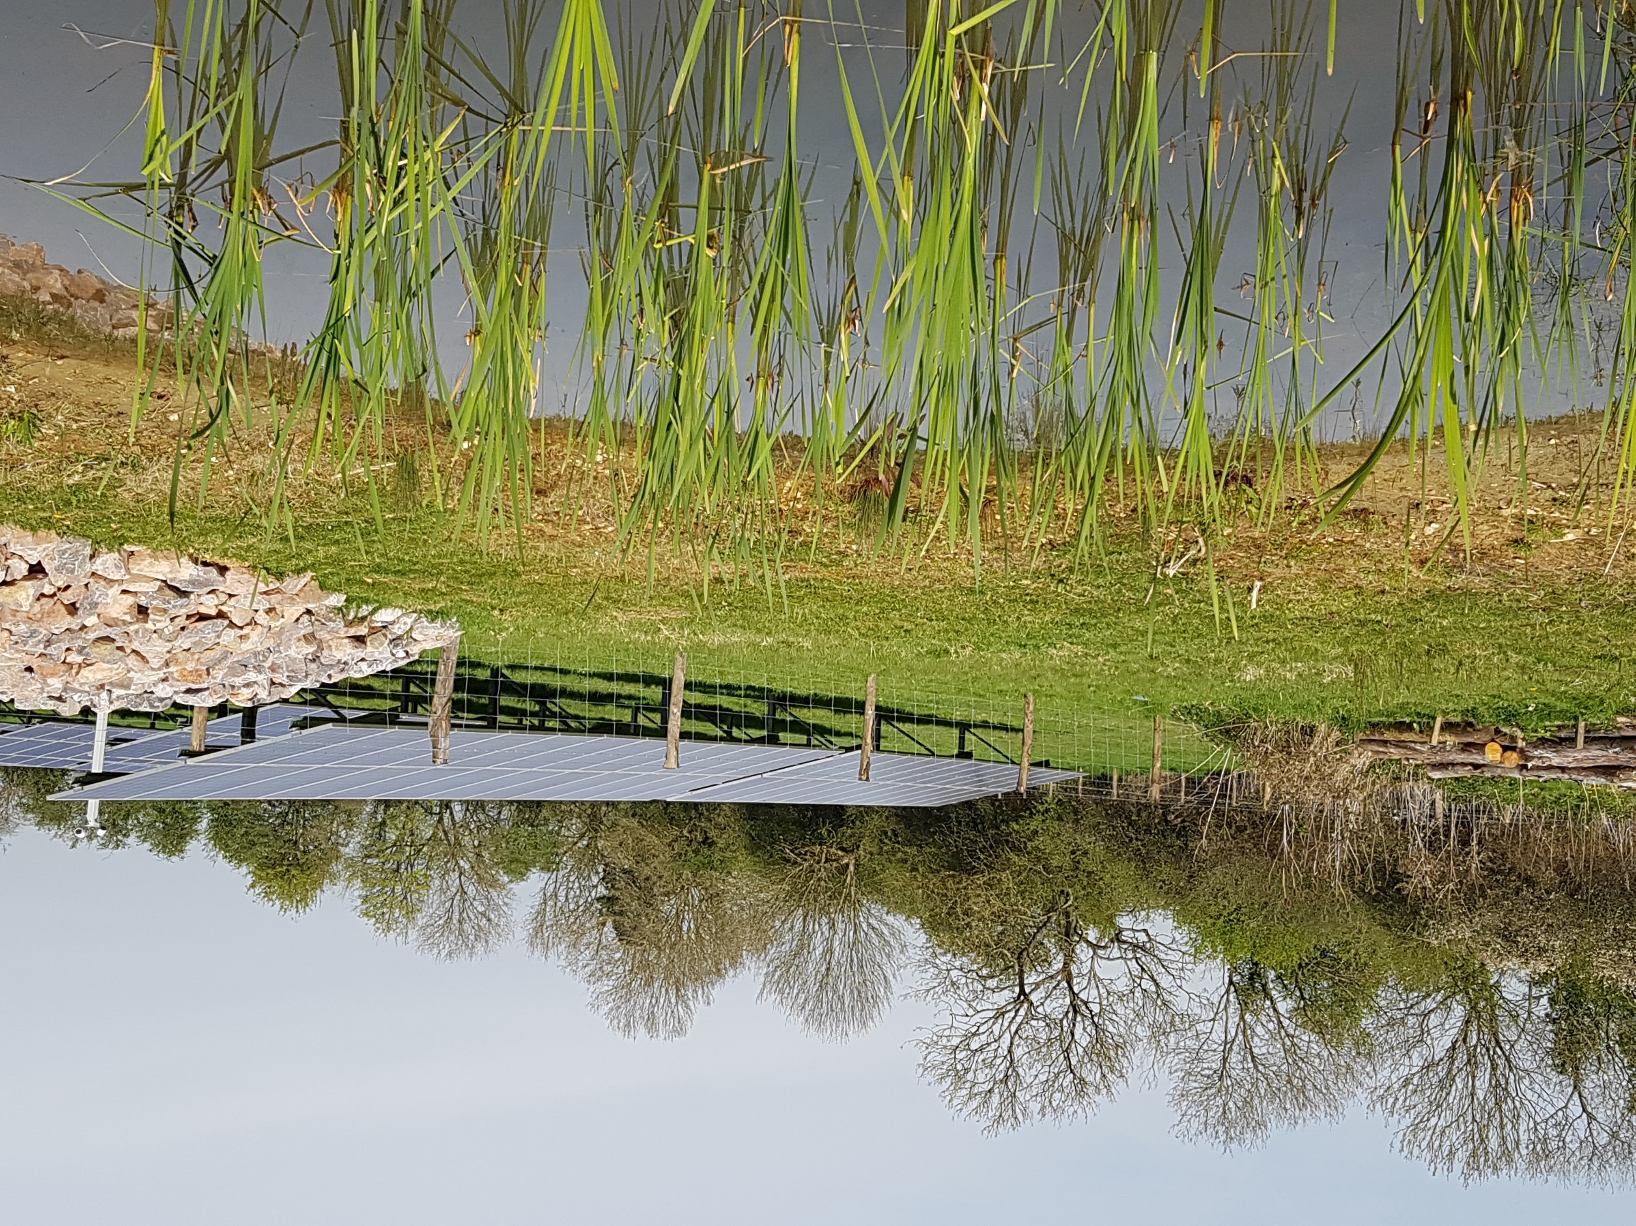
Notes:
5* newt hotel created
Frogs have moved in

Slide 9
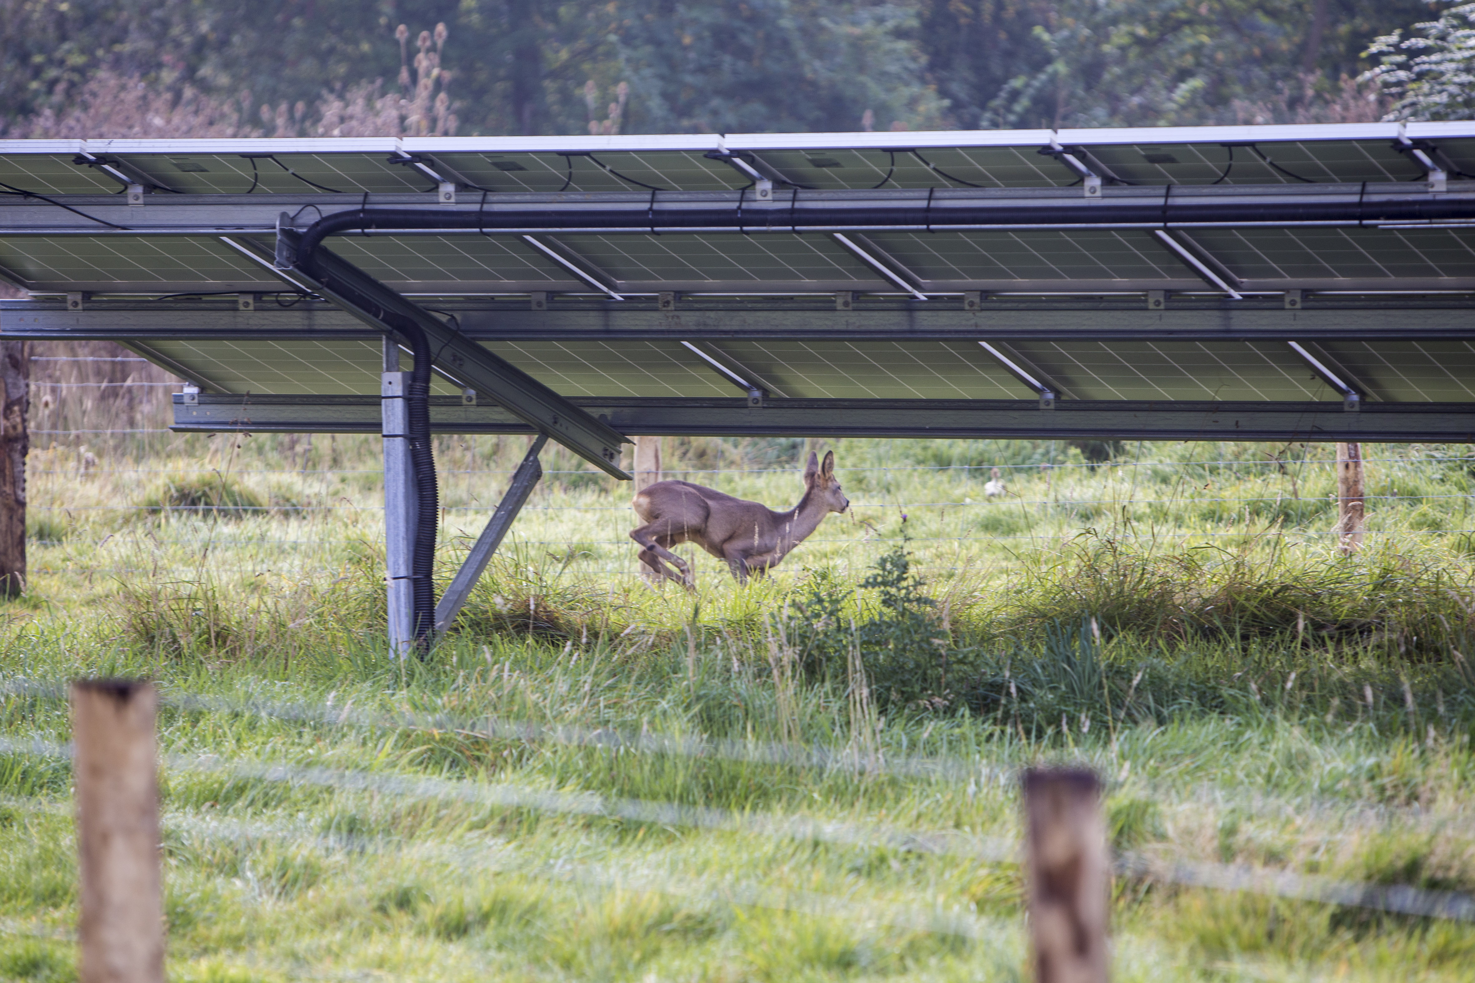
Notes:
Roe deer

Slide 10
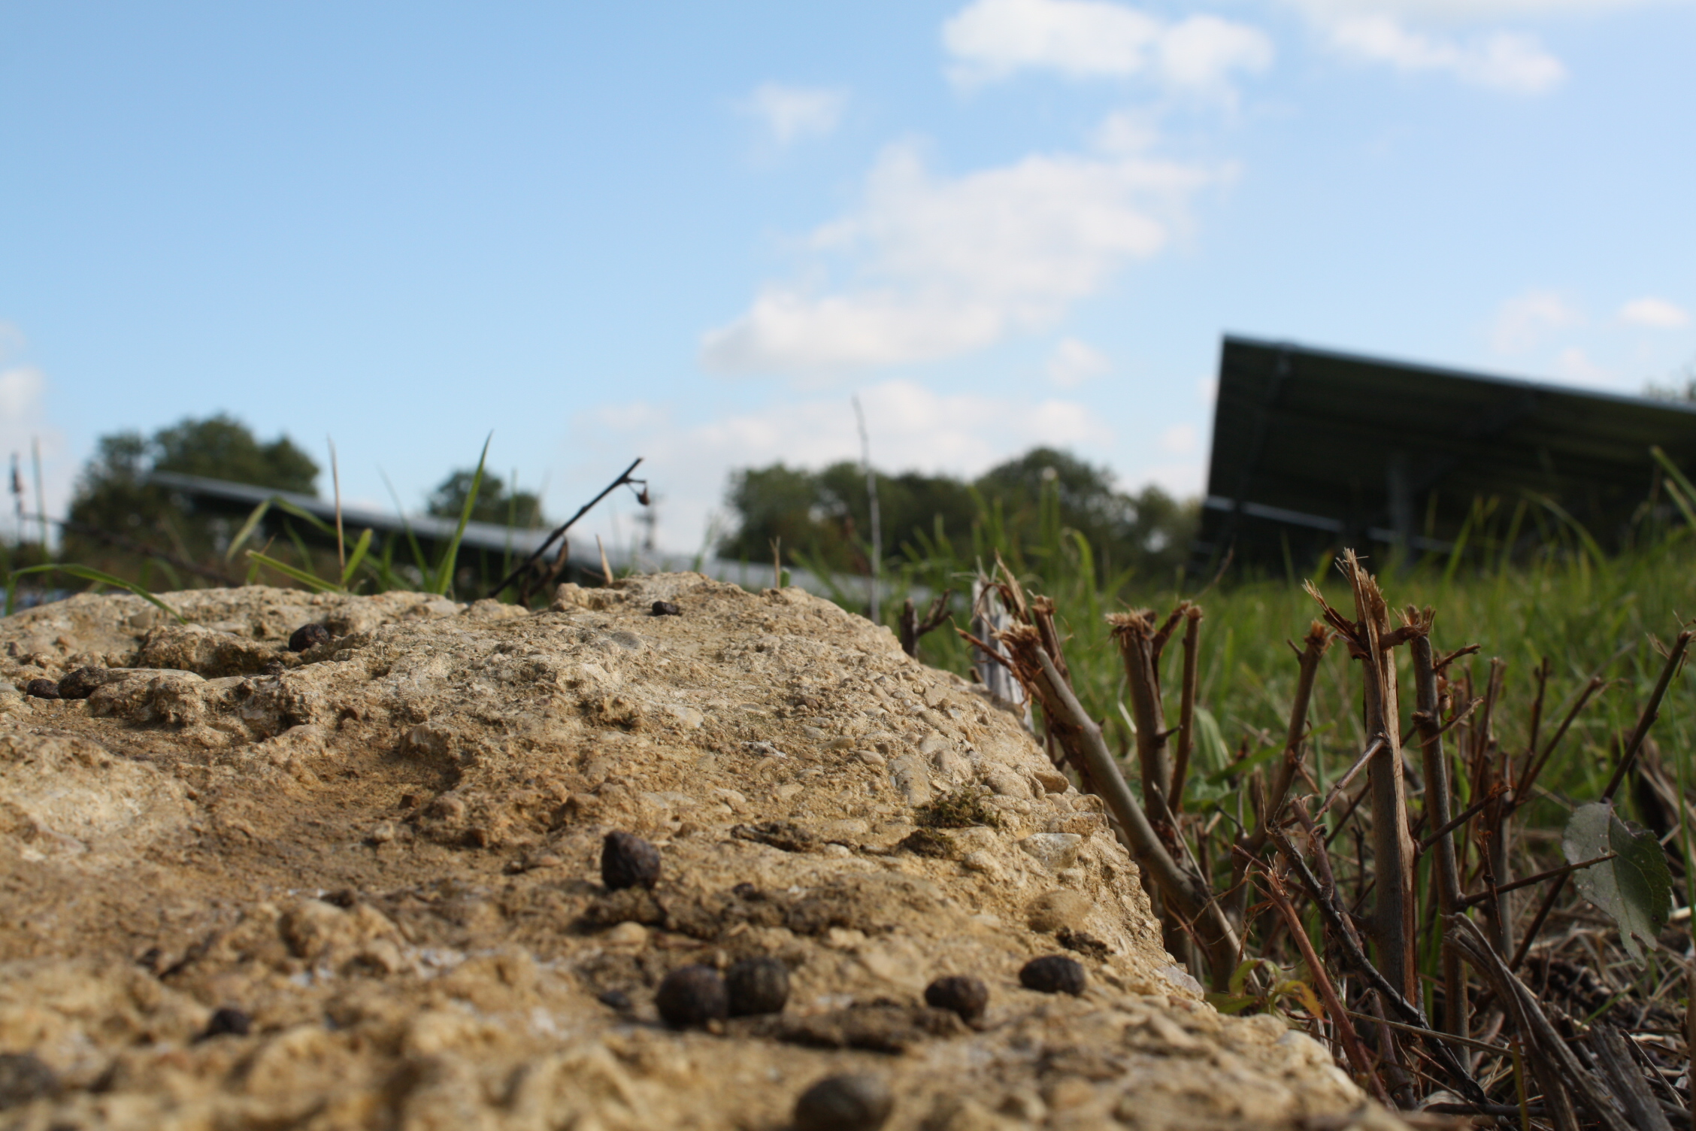
Notes:
Brown hares or at least evidence of them!

Slide 11
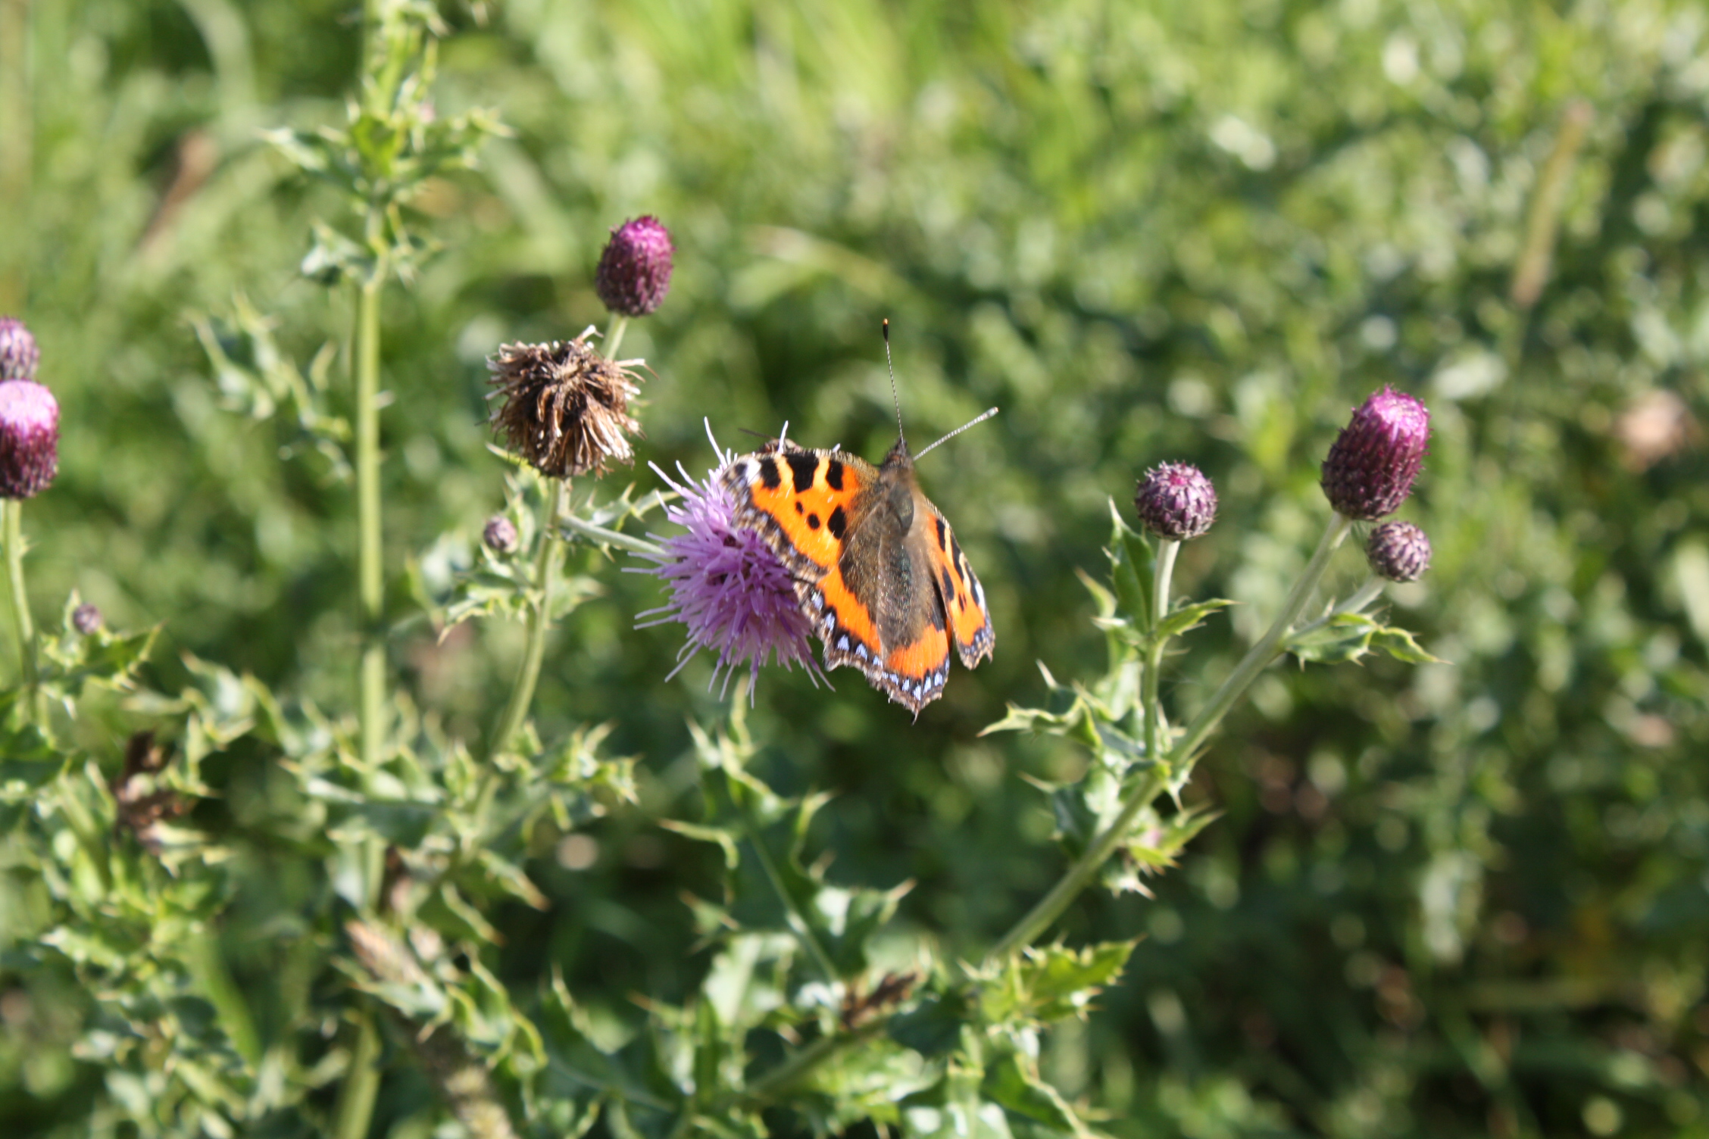
Notes:
Butterflies
Also – several different bat species

Slide 12
Some lessons……
No two sites are the same:
Baseline / Legacy biodiversity
Suitability for grazing
Construction impact
Even with WWT behind us its still hard work
It takes attention, momentum and money
Priority is still return to investors BUT..
A lot of our members are involved because of biodiversity and nature aspect
Partnerships and roles take time to establish
Biodiversity takes time
Notes:
Chelworth = adjacent to WWT Blakehill Nature reserve
Also + 3 x rooftop schemes
Issues / barriers – construction, maintenance, operations, suitability for grazing?
Separating O&M and land mgt / biodiversity / ecological monitoring

Slide 13
What’s Next……
Bat and bird boxes and raptor perches
Wildflower seeding at Braydon using WWT wildflower-rich green hay
Bees?
Improve and integrate land management plans
Disaggregate land management from land maintenance within O&M contracts
Ecological monitoring regime established timed to feed in to annual budget setting
Looking at sources of additional funding for further development

